Slide 1


OneDrive Sync Performance Training
Enhancing efficiency in cloud file synchronization
Notes:
---

Slide 2
Understanding OneDrive Sync Challenges
Notes:
Why OneDrive Sync Slows Down

Slide 3
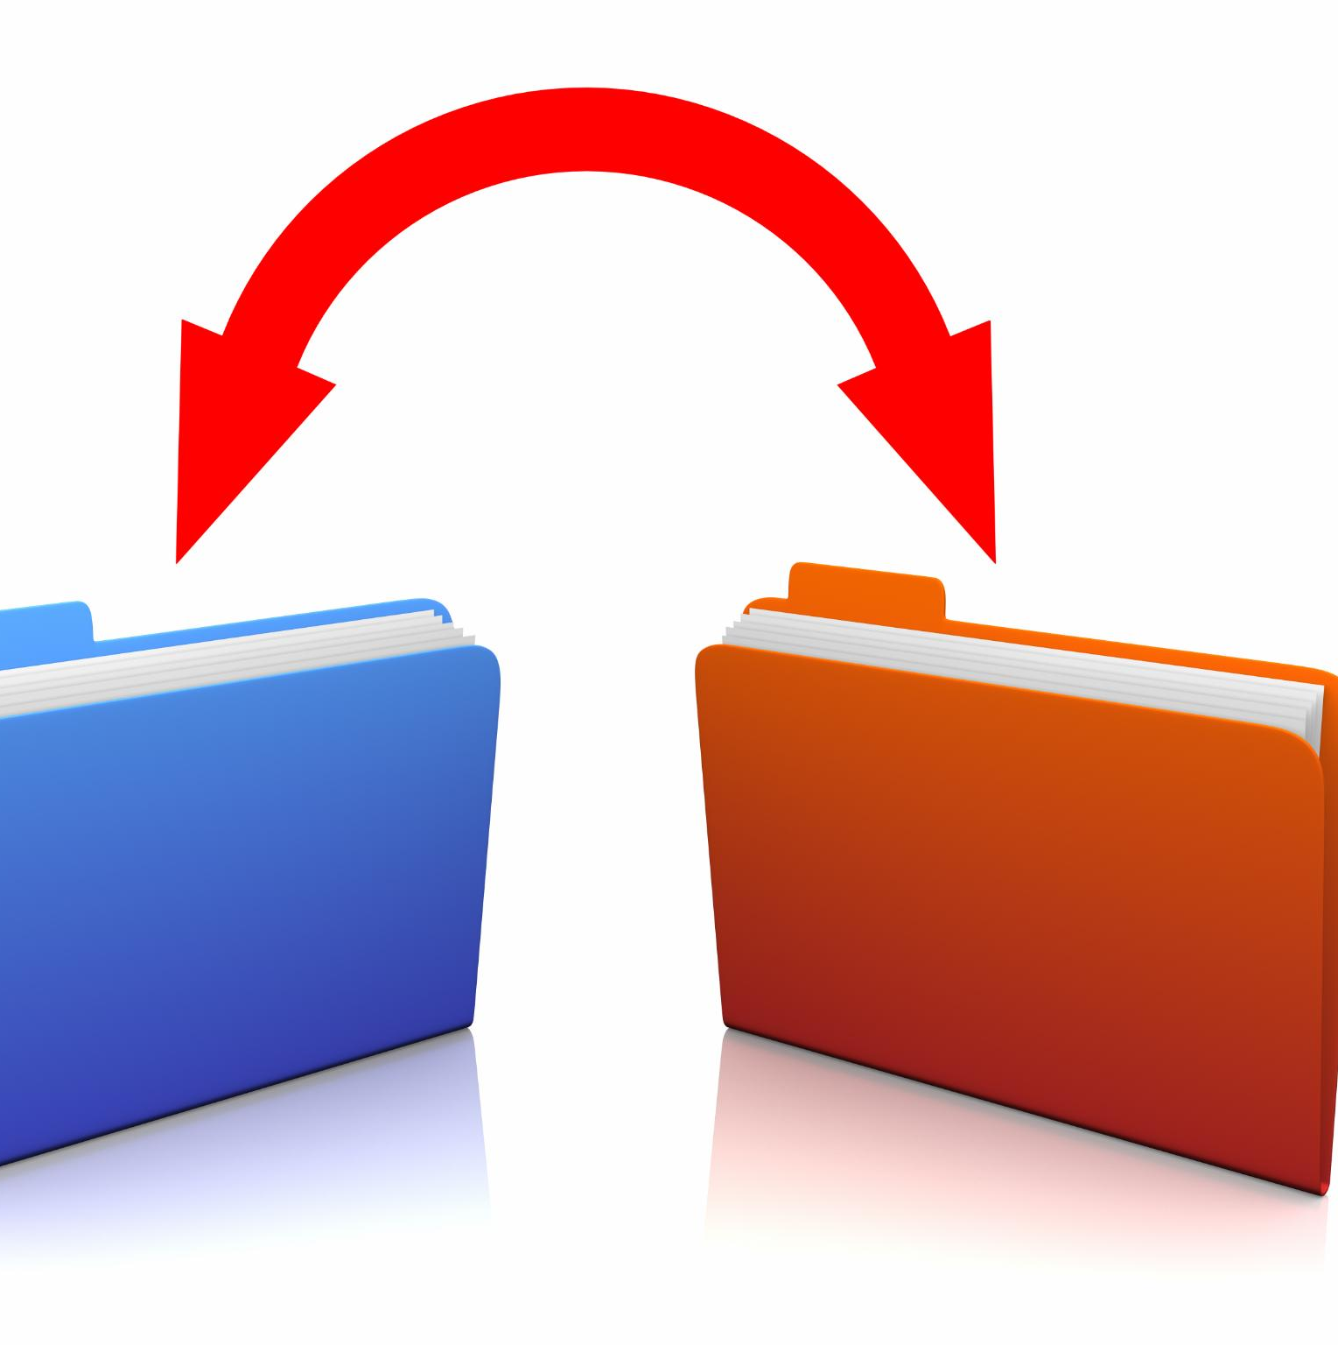
Why OneDrive Sync Slows Down
Large Library Size
  Syncing slows significantly when libraries exceed 100,000 items, causing delays regardless of total storage.
Many Small Files
  Syncing many small files strains the engine as each file requires separate processing, reducing speed.
Network Bandwidth Constraints
  Limited upload speed and unstable connections cause sync delays and stalls despite fast networks.
Local System Resource Limits
  CPU, RAM, and disk usage bottlenecks during indexing impact OneDrive syncing performance.
Notes:
OneDrive sync performance issues often stem from several key factors that impact both speed and reliability. First, the sheer number of items in a single library is the most significant contributor to slow syncing. Microsoft recommends keeping libraries under 100,000 items, as exceeding 300,000 items can cause severe delays regardless of total storage size. Second, syncing large batches of small files, such as logs or design assets, can overwhelm the sync engine because each file requires individual processing. Third, network bandwidth plays a critical role; OneDrive relies heavily on upload speed, and congested or unstable connections can stall synchronization even on fast networks. Fourth, local system resources such as CPU, RAM, and disk I/O can become bottlenecks when OneDrive is indexing or scanning large folder structures, particularly on Windows 11 systems. Finally, client-side issues like corrupted sync states or long-running sessions can accumulate glitches, requiring periodic restarts or resets to restore normal operation. Understanding these root causes helps users adopt best practices to minimize delays and prevent data conflicts. By addressing these factors proactively, organizations can ensure smoother workflows and reduce frustration caused by slow or inconsistent syncing.

Slide 4
Best Practices for Faster Sync
Notes:
Optimizing Folder Structure and Item Counts, Using Files On-Demand and Smart Syncing

Slide 5

Optimizing Folder Structure and Item Counts
Manage Folder and Item Counts
  Sync efficiency depends on the number of files, not total storage size, with fewer than 100,000 items ideal per library.
Selective Folder Syncing
  Avoid syncing entire libraries; sync only essential folders to reduce client workload and conserve resources.
Archiving and Project Subfolders
  Archive old files and break large projects into subfolders to prevent sync delays and data conflicts.
Notes:
One of the most effective strategies for improving OneDrive sync performance is managing folder structure and item counts. The number of files in a library, not the total storage size, determines sync efficiency. Libraries approaching or exceeding 300,000 items can experience severe delays, so splitting large libraries into smaller, more manageable ones is essential. Aim for fewer than 100,000 items per library whenever possible. Additionally, avoid syncing entire SharePoint libraries to local devices unless necessary. Instead, selectively sync only the folders you need for daily work. This reduces the workload on the OneDrive client and minimizes resource consumption. Archiving old or rarely accessed files to non-synced locations can also help maintain optimal performance. For teams handling large projects, consider breaking them into subfolders to prevent overwhelming the sync engine. These structural adjustments not only speed up synchronization but also reduce the risk of conflicts and data loss. By implementing these practices, organizations can maintain a streamlined environment that supports efficient collaboration without sacrificing reliability.

Slide 6

Using Files On-Demand and Smart Syncing
Files On-Demand Overview
  Files On-Demand reduces local resource use by storing files in the cloud until accessed.
Activation Steps
  Enable Files On-Demand via OneDrive settings under Sync and Backup in Advanced settings.
Smart Syncing Practices
  Avoid syncing unnecessary folders to reduce background activity and network traffic.
Performance Benefits
  Combining Files On-Demand with smart syncing improves device responsiveness and longevity.
Notes:
Files On-Demand is a powerful feature that significantly improves OneDrive performance by reducing local resource usage. When enabled, Files On-Demand keeps files in the cloud and only downloads them when accessed, minimizing disk space consumption and lowering CPU and memory load. This feature is particularly useful for users working with large datasets or limited storage capacity. To activate Files On-Demand, navigate to OneDrive settings, select Sync and Backup, and enable the option under Advanced settings. Additionally, smart syncing practices can further enhance performance. Avoid syncing folders that are not needed for daily operations, and instead access them online when required. This selective approach prevents unnecessary background activity and reduces network traffic. Combining Files On-Demand with selective syncing ensures that your device remains responsive while maintaining access to essential files. These strategies not only improve speed but also extend device longevity by reducing wear on storage components. Implementing these features across the organization can lead to a noticeable improvement in user experience and productivity.

Slide 7
Troubleshooting and Quick Fixes
Notes:
Restarting and Resetting OneDrive, Network and Bandwidth Optimization

Slide 8

Restarting and Resetting OneDrive
Restarting OneDrive
  Restarting OneDrive clears temporary glitches and refreshes the sync process to improve performance quickly.
Resetting OneDrive Client
  Resetting OneDrive clears corrupted sync settings and restores functionality using a specific reset command.
Benefits of Restart and Reset
  These actions prevent downtime, improve sync reliability, and empower users to solve issues independently.
Notes:
When OneDrive appears stuck or sync performance deteriorates, restarting or resetting the client often resolves the issue. A simple restart clears temporary glitches that accumulate during long sync sessions. To restart, click the OneDrive icon in the system tray, select Help & Settings, and choose Quit OneDrive. Then relaunch the application from the Start menu. If restarting does not help, resetting the OneDrive client can restore normal functionality by clearing corrupted sync settings. This can be done by running the command `%localappdata%\Microsoft\OneDrive\onedrive.exe /reset` in the Run dialog. After the reset, OneDrive will automatically relaunch and begin re-syncing your data. These steps are safe and do not delete your files, but they can significantly improve performance by refreshing the sync relationship. Regularly applying these troubleshooting measures can prevent prolonged downtime and ensure that OneDrive remains responsive. Training users to perform these actions empowers them to resolve common issues quickly without waiting for IT intervention.

Slide 9

Network and Bandwidth Optimization
Use Wired Ethernet
  Wired Ethernet connections provide more stability and faster speeds than Wi-Fi for syncing large files.
Optimize Wi-Fi Setup
  Position devices close to the router and reduce interference to improve Wi-Fi stability during syncs.
Manage Bandwidth Usage
  Pause bandwidth-heavy activities like streaming and large downloads during large sync operations to prevent congestion.
Configure OneDrive Settings
  Set upload and download rates to 'Don't limit' in OneDrive settings to maximize sync speeds.
Notes:
Network performance is a critical factor in OneDrive sync speed, especially for large uploads. To optimize bandwidth, use a wired Ethernet connection whenever possible, as it provides more stability than Wi-Fi. If Wi-Fi is the only option, position your device close to the router and minimize interference from other devices. During large sync operations, pause bandwidth-heavy activities such as video streaming or large downloads to prevent congestion. OneDrive also offers settings to control upload and download rates; ensure that these are set to 'Don't limit' under the Network tab in OneDrive settings. Testing your internet speed using tools like Speedtest can help confirm that your upload rate meets the recommended minimum of 10 Mbps for large syncs. These adjustments can dramatically reduce sync times and improve overall reliability. By educating users on these best practices, organizations can minimize delays caused by network constraints and maintain smooth collaboration across teams.

Slide 10

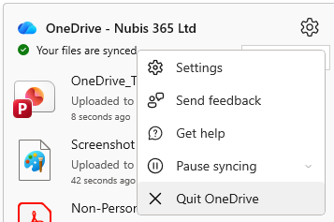

RestarTing Onedrive
Right Click the blue cloud (OneDrive)
The quickest way to restart OneDrive on Windows is through the taskbar.
Soft Restart:
1. Right-click the OneDrive cloud icon in your taskbar (bottom-right).
2. Select Pause syncing > Quit OneDrive.
3. Open your Start menu, type "OneDrive," and click the app to reopen it.
Click Settings (Cog)
Click X Quit OneDrive

Slide 11
Resetting OneDrive
Press Windows Key + R to open the Run dialog.
Copy and paste the following command and press Enter: %localappdata%\Microsoft\OneDrive\onedrive.exe /reset
Wait a few minutes. The OneDrive icon in the taskbar will disappear and then reappear.
If the icon doesn’t reappear after 2–3 minutes, manually restart it by opening the Start menu, typing "OneDrive," and clicking the app.
[!TIP] If you get a "Windows cannot find..." error, try this command instead: C:\Program Files\Microsoft OneDrive\onedrive.exe /reset

